Slide 1
Range Object
Notes:
https://www.excel-easy.com/vba/create-a-macro.html

Slide 2
Table of Contents
Using Range
Using Cell
Declare a range object
Using select
Understanding rows
Understanding columns
Copy / Paste
Clear
count

Slide 3
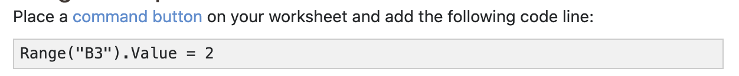
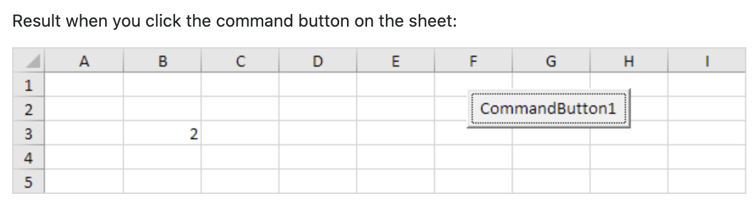
Using Range
We have learnt how to do this before, mainly as a revision.

Slide 4
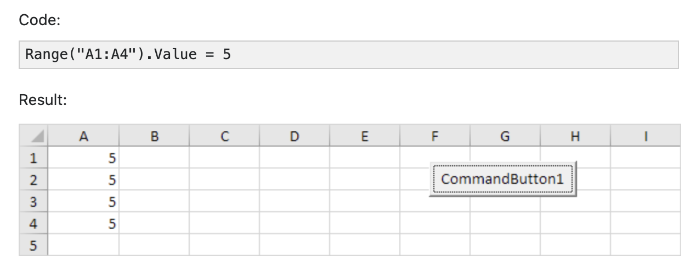
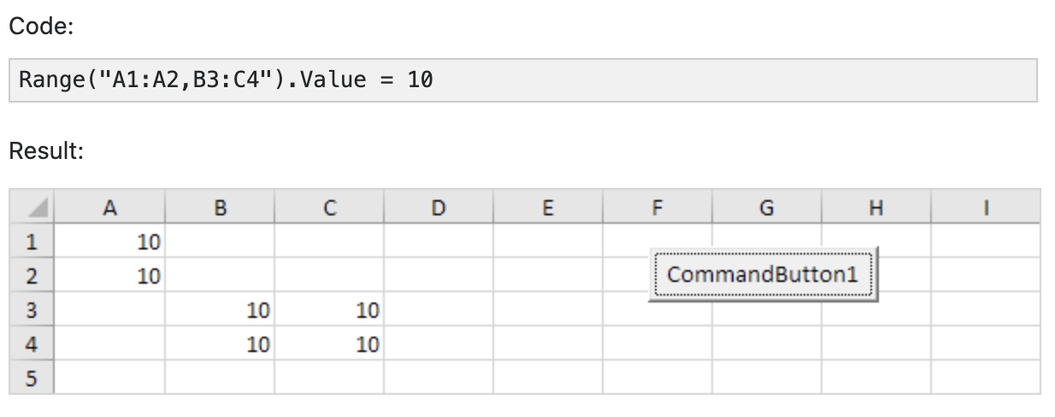
Using Range

Slide 5
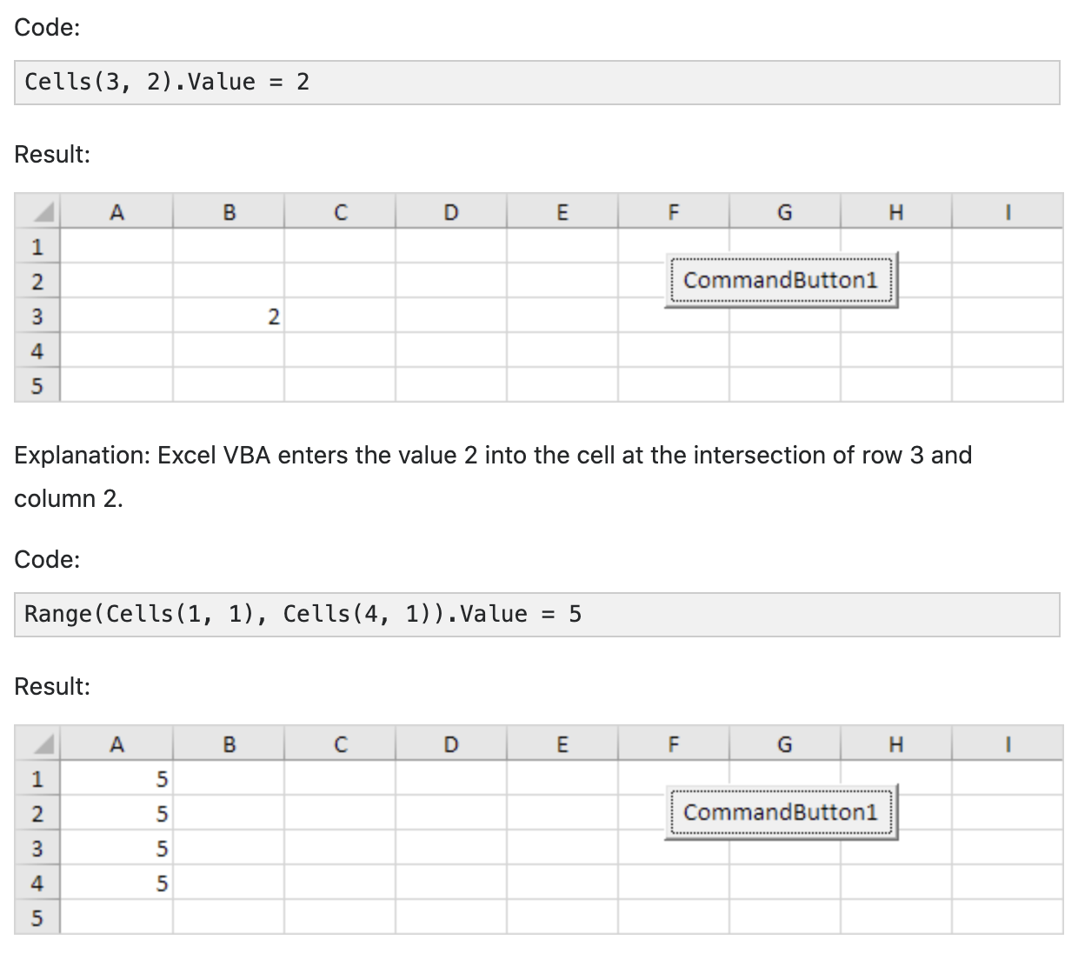
Using Cell
Instead of Range, you can also use Cells. Using Cells is particularly useful when you want to loop through ranges.

Slide 6
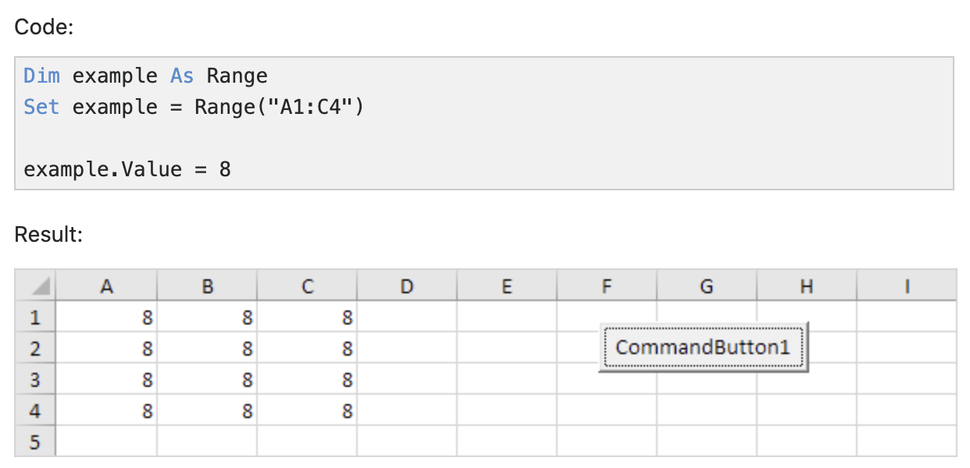
Declare a range object
You can declare a Range object by using the keywords Dim and Set

Slide 7
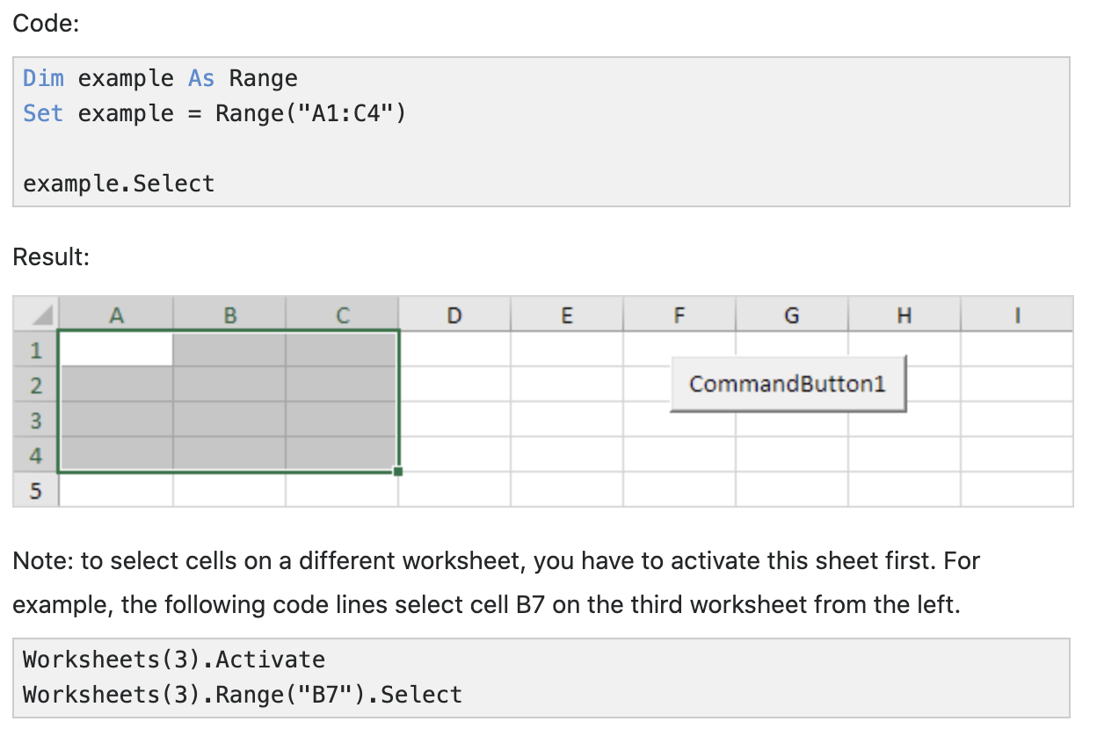
Using select
An important method of the Range object is the Select method. The Select method simply selects a range.

Slide 8
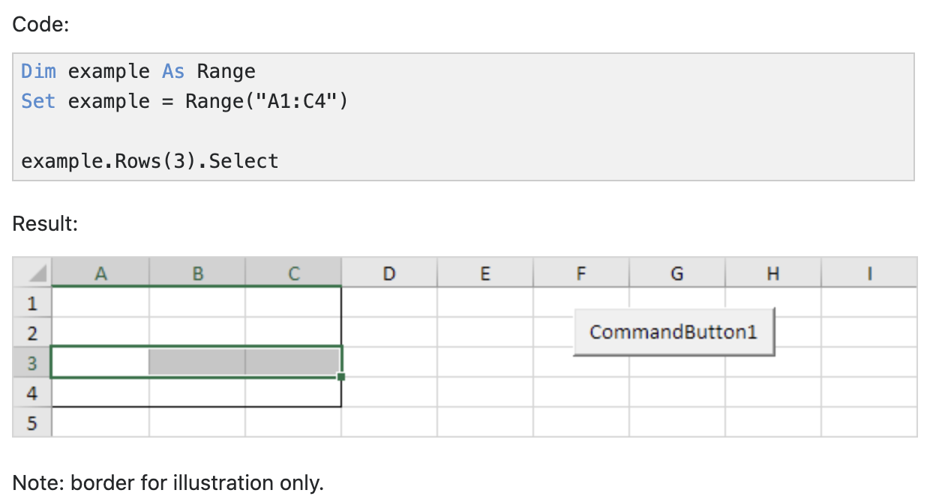
Understanding rows
The Rows property gives access to a specific row of a range.

Slide 9
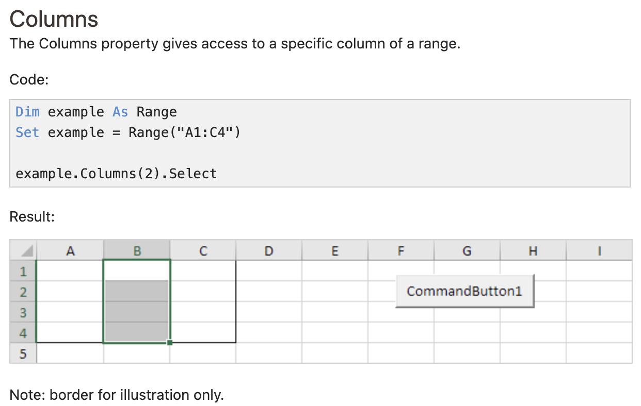
Understanding COLUMNS
The Columns property gives access to a specific column of a range.

Slide 10
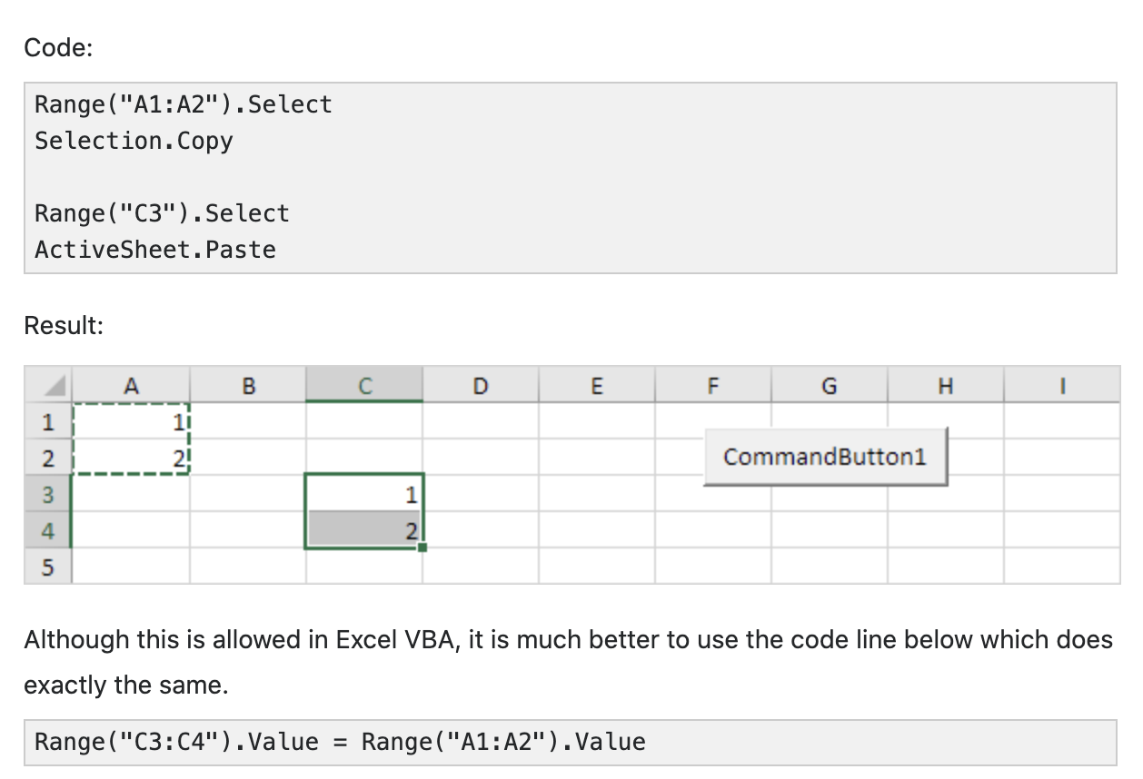
COPY / Paste
The Copy and Paste method are used to copy a range and to paste it somewhere else on the worksheet.

Slide 11
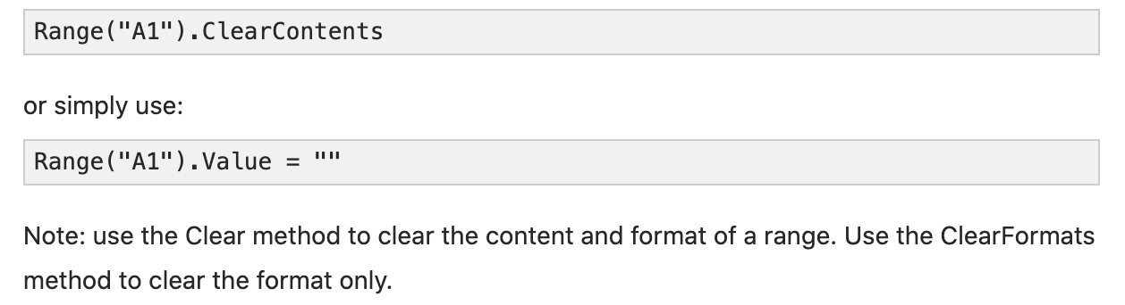
Clear
To clear the content of an Excel range, you can use the ClearContents method.

Slide 12
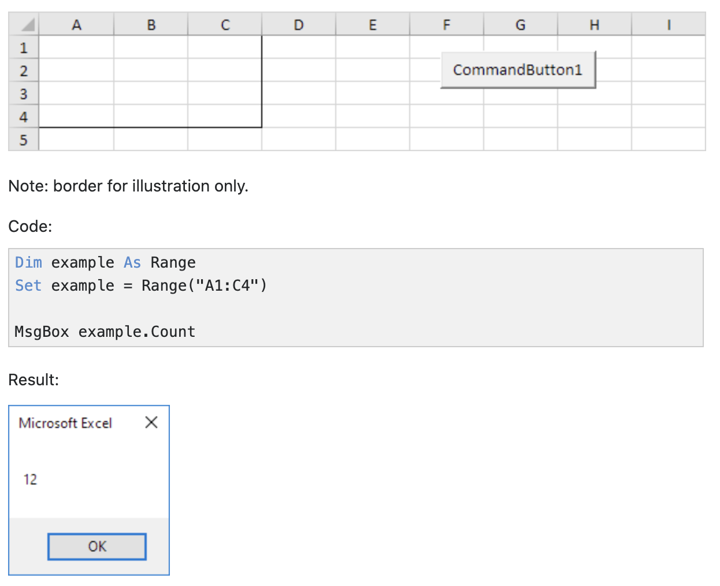
count
With the Count property, you can count the number of cells, rows and columns of a range.

Slide 13
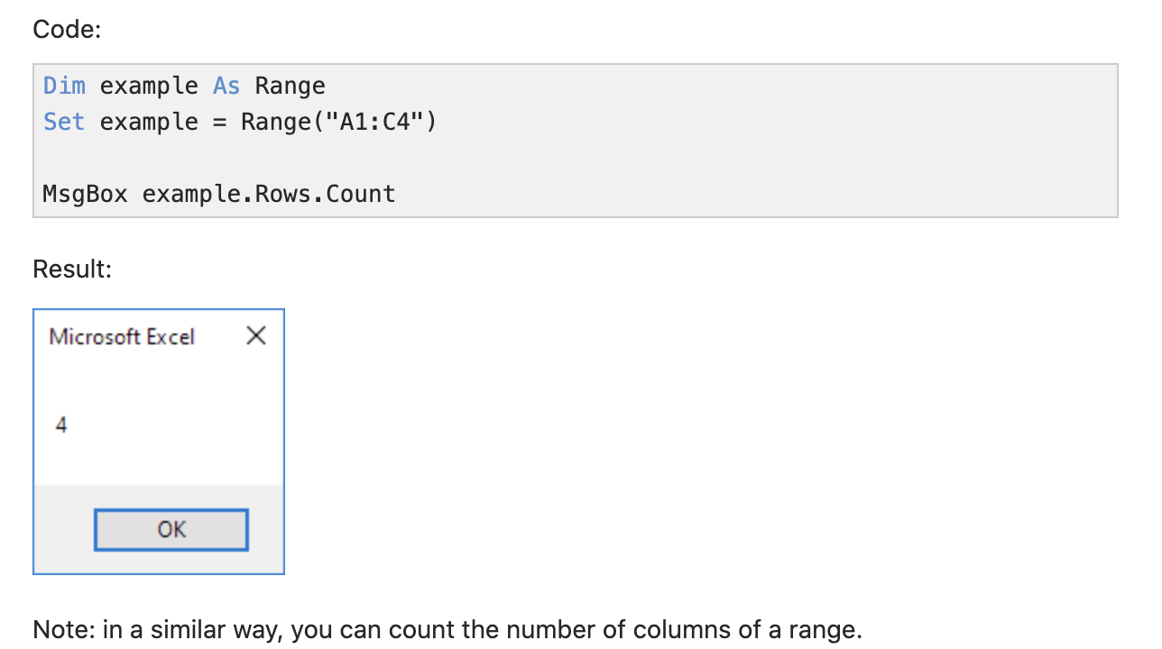
count
With the Count property, you can count the number of cells, rows and columns of a range.

Slide 14
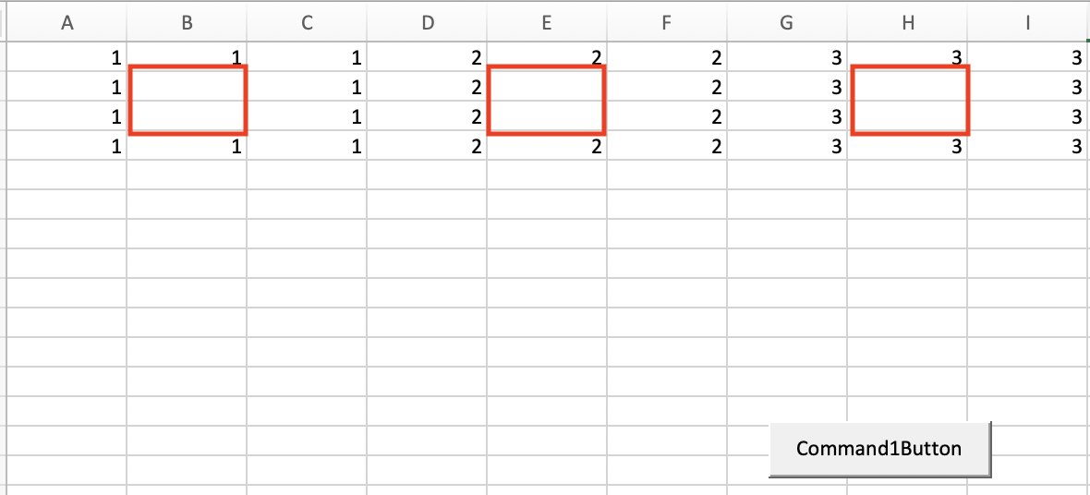
Exercise
Use excel MACROS to achieve this result
Box highlighted in red color should be empty
To be done within 5 minutes

